Slide 1
Client - Server Programming
-With respect to assignment 7

Slide 2
UDP Iterative Server
The UDP loop server reads a client's request - > processing - > from the socket each time and returns the result to the client.
Because UDP is non-connection-oriented, no client can always occupy the server. As long as the processing process is not dead-loop or time-consuming, the server can satisfy each client's request to some extent

Slide 3


Multiple Clients send requests to UDP iterative server
Client A
Client B
Client C
UDP iterative server responds simultaneously to client requests to some extent
Client D

Slide 4
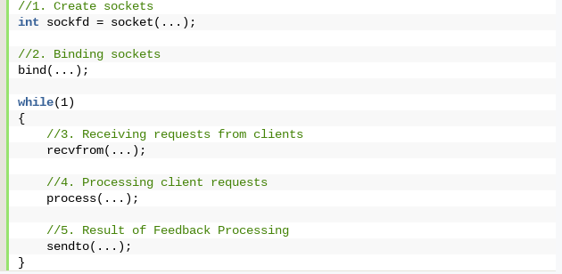
UDP Iterative Server Framework

Slide 5
TCP Iterative Server
The TCP iteration server accepts a client's connection, then processes it, completes all requests from the client, and disconnects.
The TCP iterative server can only process one client's request at a time.
Only when all the requests of the client are satisfied, the server can continue the subsequent requests. If one client occupies the server, other clients can't work, so TCP servers seldom use the iterated server model.

Slide 6
Client A sends request to TCP iterative server
Client A
TCP iterative server processes all requests of client A ,closes connection and goes to next client
Client B
Client C
Client D

Slide 7
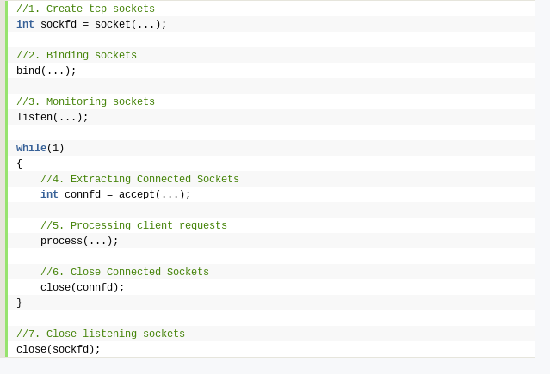
TCP Iterative Server Framework

Slide 8
Problem Statement 1 (Display time)
1. Write a TCP client-server system to allow client programs to get the system date and time from the server. When a client connects to the server, the server gets the local time on the machine and sends it to the client. The client displays the date and time on the screen, and terminates. The server should be an iterative server.

Slide 9
Creation of source code files
You need to create two files named :
<Your_Roll_Number>_time_server.c and
<Your_Roll_Number>_time_client.c

Slide 10
Input & Output
No input
Output will be server machine time

Slide 11
Compilation and Execution
For server code
gcc date_time_server.c -o server
./server 50009 (port no as command line argument)
For client code
gcc date_time_client.c -o client
./client 127.0.0.1 50009 (ip address and port no as command line arguments)

Slide 12
Demo

Slide 13
Problem Statement 2 (Display ip address for dns)
2. Write a simple UDP iterative server and client to convert a given DNS name (for example, www.google.com) into its IP address(es). The client will read the DNS name as a string from the user and send it to the server. The server will convert it to one or more IP addresses and return it back to the client. The client will then print ALL the addresses returned, and exit. For basic UDP socket communication, see the sample program given. To get the IP address corresponding to a DNS name, use the function gethostbyname(). Look up the description of the function from the man page and the tutorial on the webpage.

Slide 14
gethostbyname()
gethostbyname() takes a string like "www.yahoo.com", and returns a struct hostent which contains tons of information, including the IP address

Slide 15
Example
int i;
struct hostent *he;
struct in_addr addr;
// get the addresses of www.yahoo.com:
he = gethostbyname("www.yahoo.com");
if (he == NULL) { // do some error checking
herror("gethostbyname"); // herror(), NOT perror()
exit(1);
}
// print information about this host:
printf("Official name is: %s\n", he->h_name);
printf("IP address: %s\n", inet_ntoa(*(struct in_addr*)he->h_addr));

Slide 16
Creation of source code files
You need to create two files named :
<Your_Roll_Number>_dns_server.c and
<Your_Roll_Number>_dns_client.c

Slide 17
Input & Output
Input will be dns.
Output will be corresponding ip address for dns.

Slide 18
Compilation and Execution
For server code
gcc dns_server.c -o server
./server 50009 (port no as command line argument)
For client code
gcc dns_client.c -o client
./client 127.0.0.1 50009 (ip address and port no as command line arguments)

Slide 19
Demo

Slide 20
Problem Statement 3 (Combined Server)
3. Now suppose that the same server will act both as the time server in Problem 1 and the DNS server in Problem 2. Thus, some clients will request over the UDP socket for name-to-IP conversion, and some will connect over a TCP socket for the time. Thus, the server now needs to open both a TCP socket and a UDP socket, and accept request from any one (using the accept() + read()/send() call for TCP, and recvfrom() call for UDP), whichever comes first. Use the select() call to make the server wait for any one of the two connections, and handle whichever comes first. All handlings are iterative.

Slide 21
Important Concepts
Select function is used to select between TCP and UDP socket. This function gives instructions to the kernel to wait for any of the multiple events to occur and awakens the process only after one or more events occur or a specified time passes.
Server:
Create TCP i.e Listening socket
Create a UDP socket
Bind both socket to server address.
Initialize a descriptor set for select and calculate maximum of 2 descriptor for which we will wait
Call select and get the ready descriptor(TCP or UDP)
Handle new connection if ready descriptor is of TCP OR receive data gram if ready descriptor is of UDP

Slide 22
Select continued..
fd_set
An fd_set is a set of sockets to "monitor" for some activity. There are four useful macros : FD_CLR, FD_ISSET, FD_SET, FD_ZERO for dealing with an fd_set.
FD_ZERO - Clear an fd_set
FD_ISSET - Check if a descriptor is in an fd_set
FD_SET - Add a descriptor to an fd_set
FD_CLR - Remove a descriptor from an fd_set

Slide 23
Select framework
//set of socket descriptors
fd_set readfds;
//socket to set
FD_SET( s , &readfds);
select function
The select method takes a list of socket for monitoring them. Here is how :
activity = select( max_fd + 1 , &readfds , NULL , NULL , NULL);

Slide 24
Creation of source code files
You need to create two client files and one server named :
<Your_Roll_Number>_combined_server.c
<Your_Roll_Number>_time_client.c
<Your_Roll_Number>_dns_client.c

Slide 25
Input & Output
Input will be the client code i.e time client program or dns client program
Output will be either displaying time of server or ip address for dns based on the first request as it comes.

Slide 26
Compilation and Execution
For server code
gcc combined_server.c -o server
./server 50009 (port no as command line argument)
For client time code
gcc date_time_client.c -o client1
./client1 127.0.0.1 50009 (ip address and port no as command line arguments)
For client dns code
gcc dns_client.c -o client2
./client2 127.0.0.1 50009 (ip address and port no as command line arguments)

Slide 27
THANK YOU

